Slide 1
Faculty Senate
October 19, 2017
Dr. Robert J. Marley
Provost and Executive Vice Chancellor for Academic Affairs

Slide 2
Outline
Strategic Planning Update
New Faculty Support Distribution
Division Updates
Question

Slide 3
Strategic Planning Committee
Name | Dept. |  | Name | Dept.
Robert Marley, Chair | Provost |  | Sahra Sedighsarvestani | ECE/Faculty Senate
Barb Prewett | Student Affairs |  | VA Samaranayake | Math/Stat
Edna Grover-Bisker | Student Affairs |  | Susan Murray, Co-Chair - CASB | Psych Sci
Cheryl McKay | Univ Comm |  | Doug Bristow | MAE
Darlene Ramsay | Univ Advancement |  | Franca Oboh-Ikuenobe | GGPE
Elizabeth Smith | Gov Relations |  | Jeanne Stanley | ALP
Chris Ramsay | Academic Support |  | Braden Lusk, Co-Chair - CEC | MNE
Anthony Petroy | Dist/Global |  | Matt Thimgan | Biology
Ben White | CDO |  | Stuart Baur | Civil Engr
Anas Massri | Finance |  | Scottie Thomas | Undergrad student
Lucretia Eaton | Finance/Staff |  | Palash K. Bhowmik | Graduate student
Mariesa Crow | Research/OSP |  | Rose Horton, Ex-Officio | Planning
Kate Drowne | VP-Dean CASB |  | Lisa Cerney, Ex-Officio | Finance
Bruce McMillin | VP-Dean CEC |  | Krista Chambers, Ex-Officio | Scheduling/Deadlines
Richard Dawes | Chemistry/Faculty Senate

Slide 4
Strategic Planning Timeline
October 1
SPC Named by Chancellor
December 1
First draft presented by SPC to Chancellor
Open forums December 5th and 6th for feedback
Copy provided to System Review Team
January 1 (2018)
Feedback from System Review Team and constituents provided to SPC
February 1
Second draft due to System Review Team
Ongoing input and revisions through March
April 1
Final drafts submitted to System
April 13
Review and approval by Board of Curators

Slide 5
Distribution of New Faculty Support Funds
ITEM | AMOUNT
Centrally Distributed Faculty Awards Pre-Med Advisor (1 mo. Sum) HPC Technician (Salary & Benefits) Sub-Total | $25,000 $13,537 $67,685 $106,222 | 10.6%
CASB New Faculty Astrophysics, Rhetoric of Science, Bio/Ecology-Director Field Station Sub-Total | $300,000 $300,000 | 30.0%
CEC New Faculty Biomaterials, Geotechnical Engr., CS NTT Returning Administrator to Faculty Sub-Total | $382,380 $211,398 $593,778 | 59.4%
TOTAL | $1,000,000 | 100.0%

Slide 6
QUESTIONS?

Slide 7
Division Updates
Faculty Senate Meeting
Thursday, October 19, 2017

Slide 8
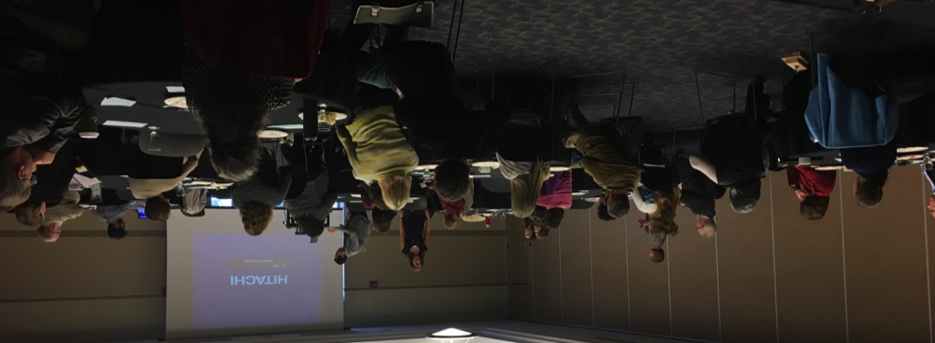
Center for Advancing Faculty Excellence “CAFÉ”
October 2017 Update
Major Accomplishments | Immediate Plans
Early Career Faculty Forum: “Advising 101 – The Basics of Advising Students”, Sept. 20th; reception with Chancellor Chris Maples at the Residence Curators’ Teaching Summit Sept. 26th: CAFÉ Steering Committee review on Oct 10th “Conversations@Work” Session on October 11th: Interviews with 20 administrators and faculty who assess faculty performance; literature review on best practices. | CERTI to become a part of CAFÉ on November 1st. OSA interviews underway (decision by COB Oct. 16th): CERTI will be co-located with CAFÉ in 207 Norwood Developing a website Announcing travel grants program $10K available to support travel to funding agencies / professional society meetings
 | Issues / Concerns
 | Nothing major; activities designed to continue building momentum and awareness of CAFE
 | Upcoming Events
 | Early Career Faculty Forum: “Proposal Budgeting and Cost Sharing”, October 18th, 4:00 p.m., 204 Library Meeting with the Department Chairs Council on Nov. 14th

Slide 9
College of Arts, Sciences, and Business
Phil Whitefield (Chemistry) has been awarded $725,500 from the Department of Transportation for the project “Examination of Engine to Engine PM Emissions Variability Using an ARP Reference Sampling and Measurement System”
Yinfa Ma (Chemistry) has been awarded $110,651 from the Department of Natural Resources for the project “Harmful Algae Bloom/Algal Toxin Treatment, and Taste/Odor Causing 2,4,6-Trichloroanisole Formation and Removal Study in Missouri Drinking Water Systems”
Phil Whitefield (Chemistry) has been awarded $89,795 from Booz Allen Hamilton for the project “Airport Cooperative Research Program 02-80-Quantifying Emissions Reductions at Airports for the use of Alternative Jet Fuels”

Slide 10
College of Arts, Sciences, and Business
Honglan Shi (Chemistry) has been awarded $20,000 from Perkin Elmer Applied BioSys, Inc. for the project “PerkinElmer Conference Travel Reimbursement for Results Dissemination with Sponsor Pre-Approval”
Dev Niyogi (Biological Sciences) has been awarded $16,813 from USDA, Forest Service for the project “Hydrology Student Internship Experience”
Dev Niyogi (Biological Sciences) has been awarded $24,998 from NSF for the project “Planning for the Ozark Research Field Station at Missouri S&T”
MS in Industrial Organizational Psychology (Psychological Science) was ranked #2 in the U.S. in both quality and affordability by AffordableColleges.com

Slide 11
College of Engineering and Computing
Elizabeth Cudney, EMSE associate professor, elected as VP of Communications for the International Academy for Quality (IAQ). She is also giving an invited talk at the World Quality Forum (Bled, Slovenia) on “Integrating the Voice of the Student in Curriculum Design through QFD”.
Joseph Smith, ChBE professor, awarded a Gulf University for Science and Technology funded project, “Collaboration in the Development of Programs in the New GUST College of Engineering”.
Mohsen Asle Zaeem, MSE assistant professor, gave a recent “Plenary Lecture” at EUROMAT 2017. Plenary Lecture Title: Competing Mechanisms between Dislocation and Phase Transformation in Plastic Deformation of Yttria-Stabilized Tetragonal Zirconia Nanopillars.

Slide 12
Office of Academic Support
Reconnect 1 – September 22nd
Offers new students to reconnect with their Opening Week mentor groups
319 students attended
Sophomore Summit – October 4th
This conference is designed to make sophomores feel supported and to provide them with the tools and resources needed to persist.
97% of attendees learned something that would help them move forward to graduation
88% said the event was worthwhile to attend
Solar House - October
4th place, highest finish ever for S&T
Heartland Users Group for Institutional Repositories
Hosted by Curtis Laws Wilson Library on October 12-13
31 attendees
Service Learning Symposium
September 28, 40 RSVP’s, Dr. Daniel Oerther was our keynote speaker

Slide 13
Office of Sponsored Programs
Summary of FY18 activities year-to-date (July)
Number of funded proposals is up by 135% for a total of 47
Total dollars is $5M which is up by 112%
Number of new proposals submitted is the same over last year: 39
Total dollars is $14M which is down by 9%
Number of active awards is up by 4% at 652
Total expenditures is $3M which is up by 1%
Net grant and contract expenditures is $3M which is up by 2%
F&A recovered is $768K which is up by 10%

Slide 14
Office of Graduate Studies
Revision of S&T Thesis/Dissertation Specifications
Haven’t been revised since 2009; will now include info on publication option, LaTeX templates, etc.
Reformatted for easier flow, better examples, clarity
Graduate Faculty will review and approve before moving forward
Enrollment update:
1,964 total grad students (4th week census) (1,929 FS16 census, 1,414 FS07 ) +1.8%
689 Doctoral (624 FS16, 344 FS07) & 1,275 Master’s (1,244 FS16, 1,070 FS07)
Degrees awarded SS 2017:
Certificates: 30 Master’s: 68 Doctoral: 31 TOTAL: 129
GEM GRAD Lab – Held Sept 29 & 30
covered at the GRAInvited URM students from around the region to participate; ~50 Students in attendance
Include three lab tours and opportunities for faculty to review resumes of some of the students
Topics D Lab include:
Why Graduate School?
How to Apply for Graduate School
How to Fund Graduate School
Voices from the Field (graduate student panel)
FS07: 344 PhD students
FS17: 689 PhD students
100% increase in 10 years

Slide 15
Office of Graduate Studies Cont.
Three Minute Thesis (3MT) – Open to all graduate students
Preliminary & Semi-Final Rounds: Tues., Oct 17, 1-3:30pm, Havener
Final Round: BEING RESCHEDULED - TBD
What about Grad School? - Oct 23, 24, & 26, 12pm, 305 Norwood Hall
Faculty and current graduate students available to talk to S&T UG students about grad school (at S&T or elsewhere)
Hosting and co-hosting ~25 student workshops this fall on writing, networking, professional development, GRE test prep, and more. Full list: grad.mst.edu/events
Fall 2017 Recruiting:
Attending 25+ graduate fairs; initiating 30+ school visits (classroom presentations, meetings with faculty, career centers, etc.)
SP 2018 New Graduate Student Orientation (NGSO) (~130 attended FS17)
Spring NGSO will be held Friday, Jan. 12, 2018, Hasselmann Alumni House

Slide 16
Enrollment Management
Thank you to everyone that contributed to the Open House on October 7. We had 154 families compared to 152 last year.
Admissions has increased the number of Discover Days to cut down on the number of families requesting individual visits. This has resulted in increased campus visitors, while decreasing the number of individual campus visits in September by 30 from last year.

Slide 17
Global Learning
Celebration of Nations on September 30th was a success. Thank you to everyone who supported the event and participated.
Call for Proposals is now ongoing for the 11th annual Teaching and Learning Technology Conference

